Slide 1

By:
Mayank Panchal

Slide 2

We will learn today
What is Laravel
Install Laravel 5 with Composer
Files structure
What is artisan and how does it save us time
Routing and route types
What is Middleware and how to use it
What is Blade ?
Database and Eloquent ORM
CRUD with validation and database connection (practical task)
Best practices when coding in Laravel

Slide 3

What is
Laravel is MVC PHP framework created by Taylor Otwell in 2011
Free open-source license with many contributors worldwide
One of the best frameworks together with Symfony, CodeIgniter, Yii
Has powerful features, saving us time
Uses Symfony packages

Slide 4
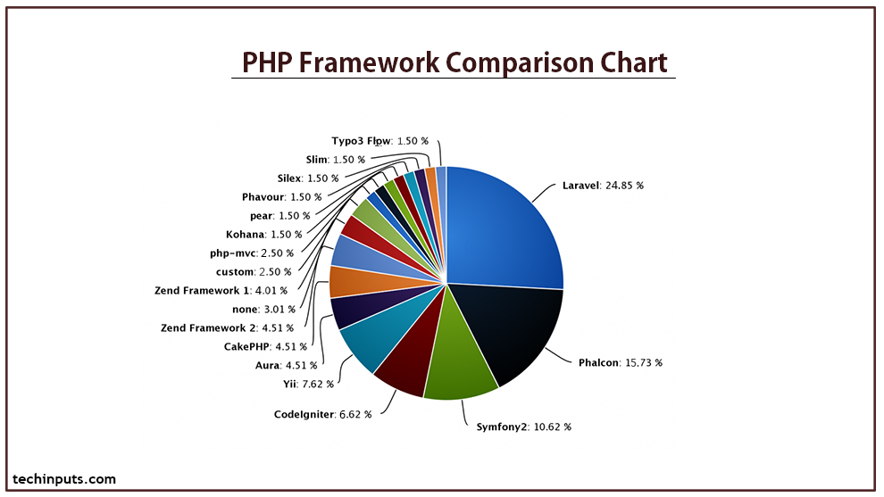

Slide 5

Features of
Eloquent ORM (object-relational mapping) – implements Active-Record
Query builder – helps you to build secured SQL queries
Restful controllers – provides a way for separating the different HTTP requests (GET, POST, DELETE, etc.)
Blade template engine – combines templates with a data model to produce views
Migrations – version control system for database, update your database easier
Database seeding – provides a way to populate database tables with test data used for testing
Pagination – easy to use advanced pagination functionalities
Forms security – provides CSRF token middleware, protecting all the forms

Slide 6

Let’s install
Laravel uses Composer to manage its dependencies
Composer is dependency management tool for PHP, like a library full of books
NOT like Yum or apt
Per project tool (vendor folder), not per system
Install by using the command:
composer create-project [PACKAGE] [DESTINATION PATH] [--FLAGS]
composer create-project laravel/laravel Laravel test

Slide 7
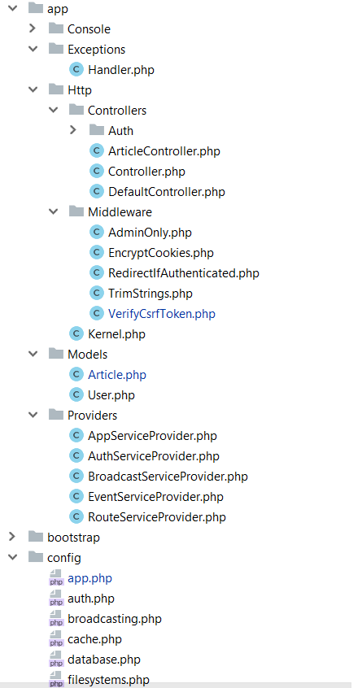
Folder Structure
app/Http folder contains the Controllers, Middlewares and Kernel file
All the models should be located in app/Models folder
The service providers that are bootstrapping functions in our app are located in app/Providers folder
All the config files are located in app/config folder

Slide 8
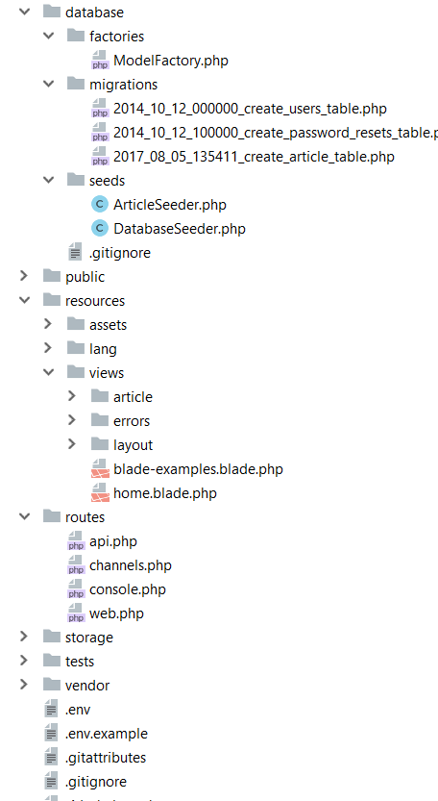
Folder Structure
Database folder contains the migrations and seeds
The public folder is the actual folder you are opening on the web server.
All JS / CSS / Images / Uploads are located there.
The resources folder contains all the translations, views and assets (SASS, LESS, JS)
that are compiled into public folder
The routes folder contains all the routes for the project
All the logs / cache files are located in storage folder
The vendor folder contains all the composer packages (dependencies)

Slide 9

Artisan!
Artisan is command-line interface for Laravel
Commands that are saving time
Generating files with artisan is recommended
Run php artisan list in the console

Slide 10
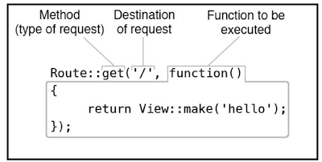
Routing
The best and easy routing system I’ve seen
Routing per middleware / prefix or namespace
Routing per request method (GET, POST, DELETE, etc.)
ALWAYS name your route !
Be careful with the routing order !
Let’s see routing examples

Slide 11
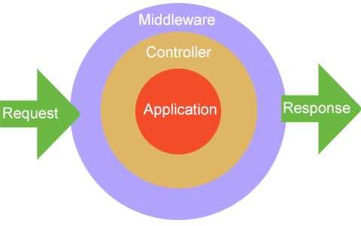
Middleware
The middleware is mechanism for filtering the HTTP requests
Laravel includes several middleware's – Authentication, CSRF Protection
The auth middleware checks if the user visiting the page is authenticated through session cookie
The CSRF token protection middleware protects your application from cross-site request forgery attacks by adding token key for each generated form
Let’s create middleware

Slide 12

Blade
Blade is the powerful template engine provided by Laravel
All the code inside blade file is compiled to static html file
Supports plain PHP
Saves time
Better components mobility, extend and include partials
Let’s take a look at few examples

Slide 13

Eloquent & Database
The Eloquent ORM (Object-relational mapping) provides simple Active Record implementation for working with the database
$article = new Article();
$article->title = ‘Article title’;
$article->description = ‘Description’;
$article->save();
INSERT INTO `article` (`title`, `description`) VALUES (‘Article title’, ‘Description’);

Slide 14
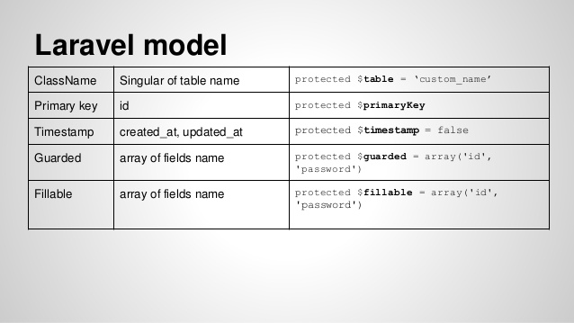
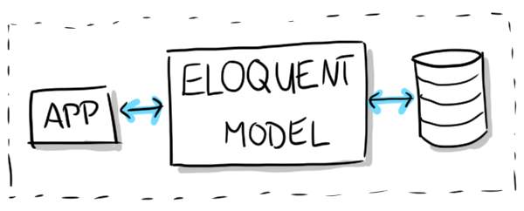
Each table has its own “Model”. You can use the model to read, insert, update or delete row from the specific table
Let’s check one model

Slide 15
Practical Task

Slide 16

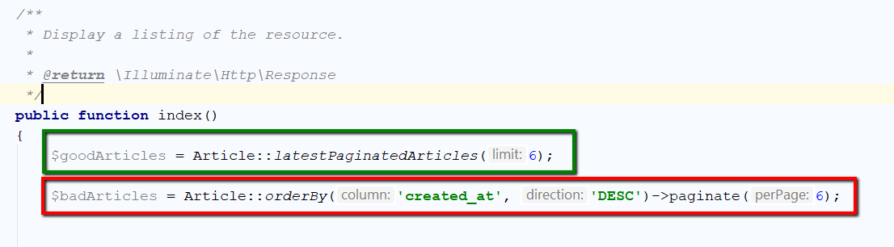
Best practices in
NEVER write queries or model logic inside the controller! The controller job is to communicate with the model and pass data to the view.

Slide 17
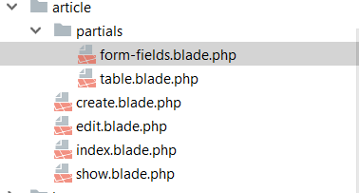
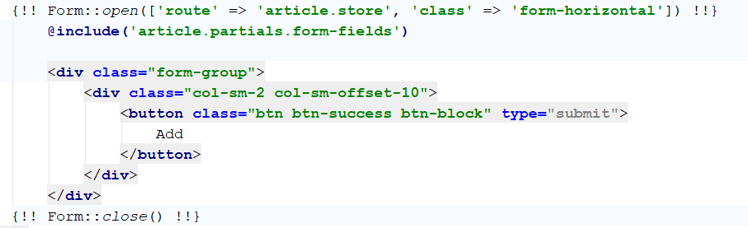
Views mobility
Extend and include partials. For example share the same form fields on 2 pages – add and edit

Slide 18
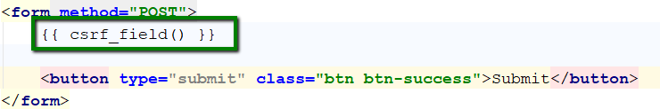
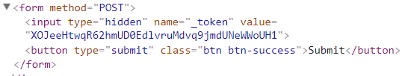
Forms security
Always use the CSRF token protection that Laravel provides in forms you create, the hackers will not be able to spam your forms and database

Slide 19
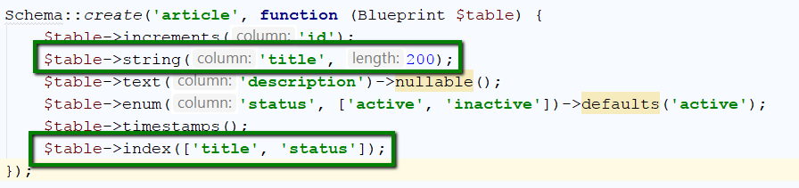
Database architecture
Be careful with the database architecture, always use the proper length for specific column and never forget the indexes for searchable columns

Slide 20
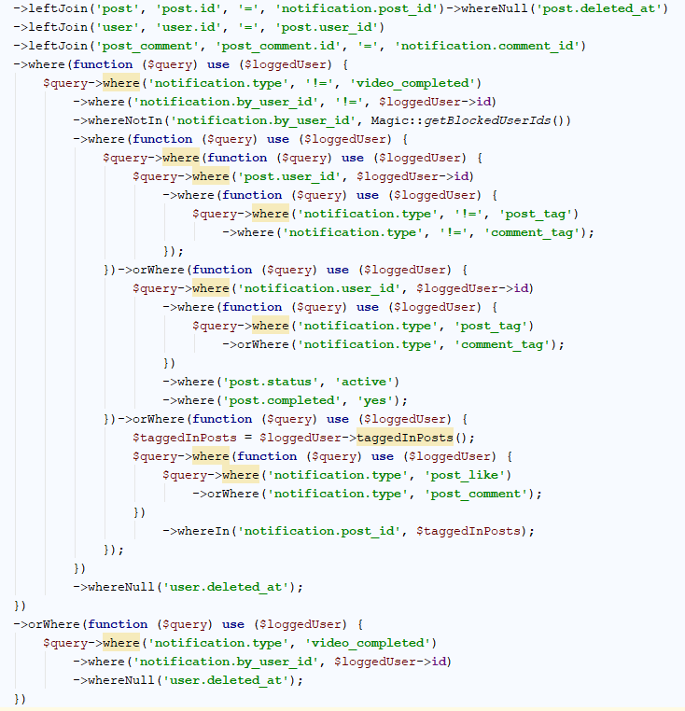
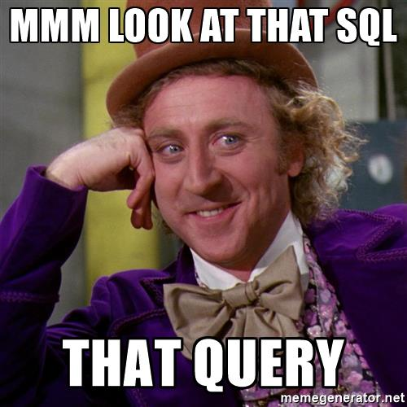
Big Query
Avoid the big query unless you really have to do it. The big query is hard to debug and understand.
You can merge the small queries into one to save the CPU time on server, but sometimes the query becomes way too big.

Slide 21

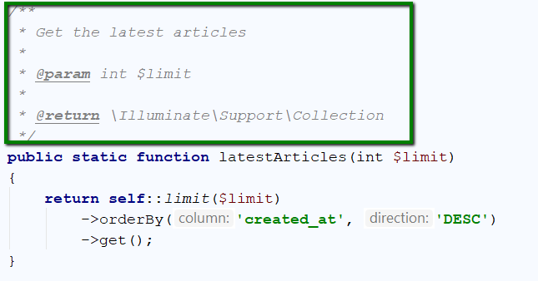
Don’t forget the PHPDoc
Don’t forget to write comments for each method or complicated logic.
The PHPDoc comments are helping the IDE to autosuggest easier and the developers to understand the piece of code

Slide 22

Thank you!
Questions

